Slide 1
C.F. Nielsen
Leadgeneration Europe, South East Asia and Australia
30/09/2022

Slide 2
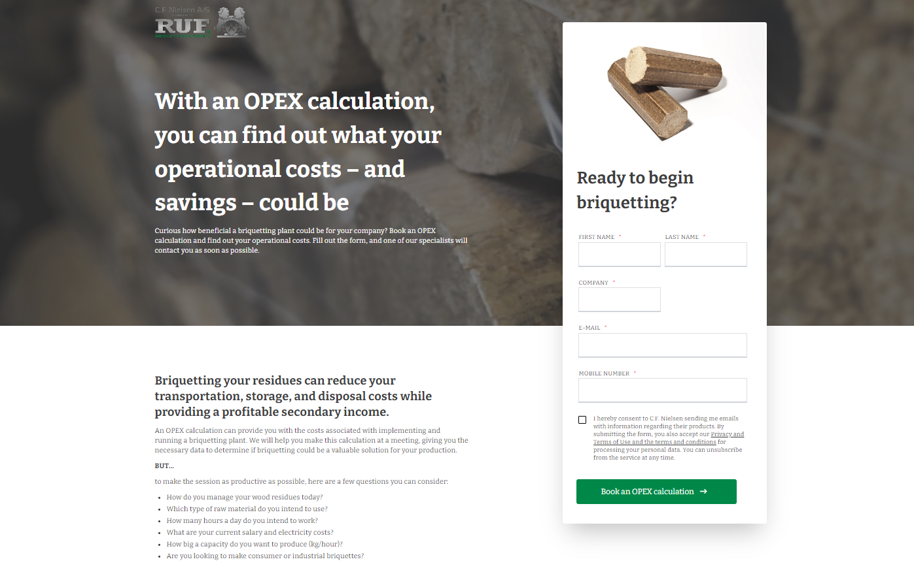
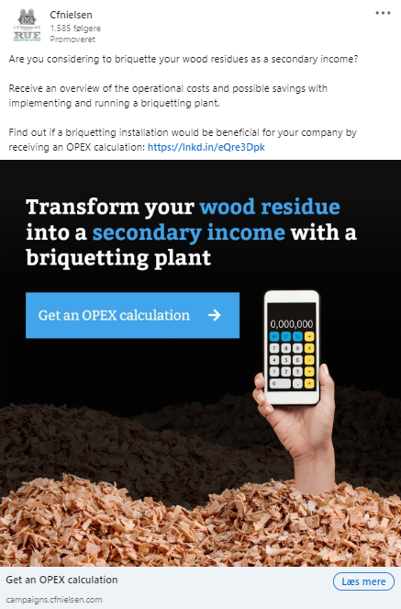
CAMPAIGN ELEMENTS
Bog
Guide
Inquire
Inquire
Notes:
Lave flere varianter af denne her

Slide 3
RESULTS – 21.06-30.09
 | Building an audience | Leadgeneration | Inquries | Total
Ad spend | 65 EUR (483 DKK) | 6.144 EUR (45.687 DKK) | 1.550 EUR (11.526 DKK) | 7.759 EUR (57.698 DKK)
Impressions* | 1.538 | 163.798 | 24.746 | 190.082
Click | 3 | 1.162 | 235 | 1.400
Leads | - | 181 | 16 | 197
Relevant leads | - | 174 | 13 | 187
Warm leads** | - | 46 | 13 | 60
Opportunities/meetings | - | 12 | 1 | 13
Cost per lead | - | 252 DKK | 720 DKK
Campaigns
Building an audience: The goal is to create website traffic and interactions with for retargeting. Ad spend: 483 kr.
Lead generation: The goal is to generate leads and get the audience to submit their contact information.
Ad spend: 45.687 DKK.
Inquries: The goal is to generate leads that wants to get in contact with C.F. Nielsen. Ad spend: 11.526 kr.
* the number of times ads are displayed
** leads that interact with mails and content, and have a lead score of +25 points

Slide 4
RESULTS – 11.05-30.09 (from start to now)
 | Building an audience | Leadgeneration | Inquries | Total
Ad spend | 631 EUR (4.692 DKK) | 9.601 EUR (71.397 DKK) | 1.588 EUR (11.809 DKK) | 11.820 EUR (87.899 DKK)
Impressions* | 16.927 | 240.416 | 24.746 | 282.089
Click | 89 | 1.875 | 235 | 2.199
Leads | - | 336 | 16 | 352
Relevant leads | - | 219 | 13 | 232
Warm leads** | - | 63 | 13 | 74
Opportunities/meetings | - | 12 | 1 | 13
Cost per lead | - | 220 DKK | 738 DKK
Campaigns
Building an audience: The goal is to create website traffic and interactions with for retargeting. Ad spend: 4.692 kr.
Lead generation: The goal is to generate leads and get the audience to submit their contact information.
Ad spend: 71.397 DKK.
Inquries: The goal is to generate leads that wants to get in contact with C.F. Nielsen. Ad spend: 11.809 kr.
* the number of times ads are displayed
** leads that interact with mails and content, and have a lead score of +25 points

Slide 5
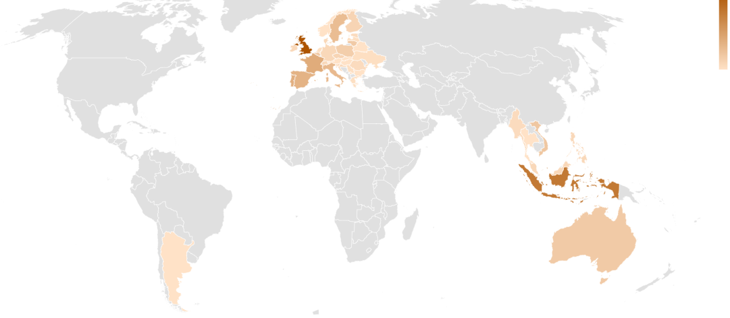
RELEVANT LEADS
43
1
Country | United Kingdom | Indonesia | France | Portugal | Spain | Italy | Sweden | Vietnam | Australia | Belgium | Lithuania | Poland | Czechia | Finland | Croatia | Denmark | Germany | Ireland | Malaysia | Philippines | Switzerland | Estonia | Myanmar | Romania | Slovenia | Greece | Kosovo | Latvia | Lithuania | Malta | Netherlands | Serbia | Ukraine | Norway | Hungary | Bulgaria | Argentina | Austria | Belatus | Singapore | Slovakia | Thailand | Ukraine | Vietnam
Count | 43 | 32 | 17 | 16 | 15 | 13 | 12 | 9 | 8 | 8 | 8 | 7 | 5 | 5 | 4 | 4 | 4 | 4 | 4 | 4 | 4 | 3 | 3 | 3 | 3 | 2 | 2 | 2 | 2 | 2 | 2 | 2 | 2 | 1 | 1 | 1 | 1 | 1 | 1 | 1 | 1 | 1 | 1 | 1

Slide 6
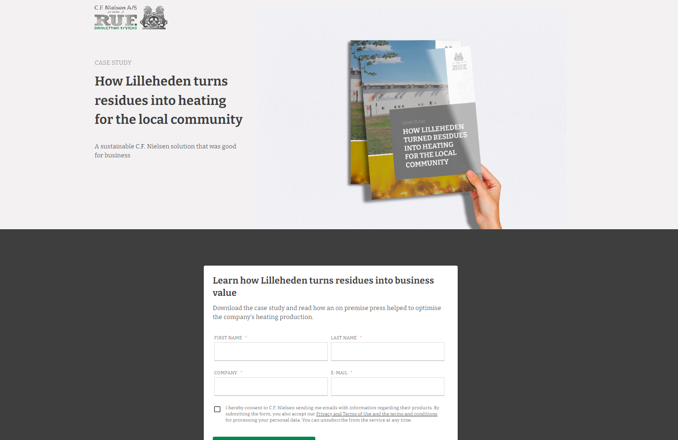
NEXT STEP
Case

Slide 7
LEAD NUTURING – E-MAIL MARKETING AUTOMATION
‘Thank you’/handover mail: Guide
Mail 1: Green energy
Mail 2: A growing trend
Mail 3: Case – Southern Pine Products
Mail 4: Tech-guide
Mail 5: Briquettes vs. pillets
Mail 6: References
Mail 7: Product range
Mail 8: Unique selling points
Mail 9: OPEX calculation
Awareness
Consideration
Decision

